Slide 1

Entanglement
A chat analysis app
Young Li, Mehak Mann, Matthew Zane, Howard Chen

Slide 2


What is our Idea?
Do you ever think about how your relationship is with your friends?
Solution: A chat log analysis application
Why?
A lot of people online might be curious about how much certain or specific people are contributing in the conversation.
This data might help them learn about their relationship or friendship.

Slide 3
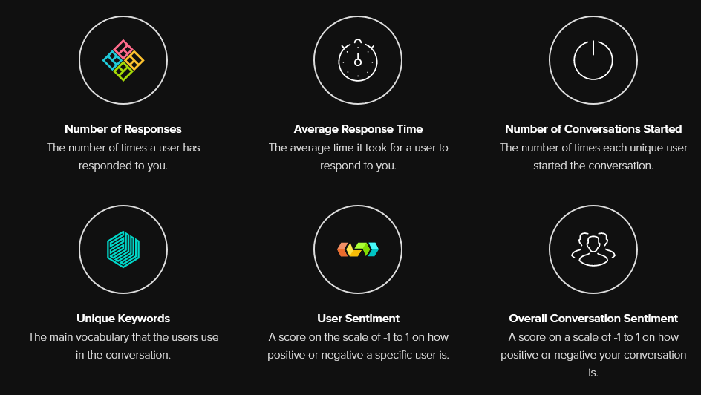
What is our product?
Notes:
Chat analysis tool.
Features
Statistics on the number of messages, the number of responses, the response times, the average response time, the number of times a conversation is started, unique keywords, user sentiment and overall conversation sentiment.
Output numbers and graphs

Slide 4
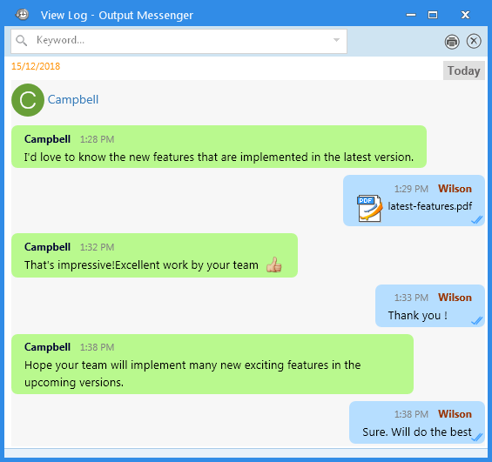
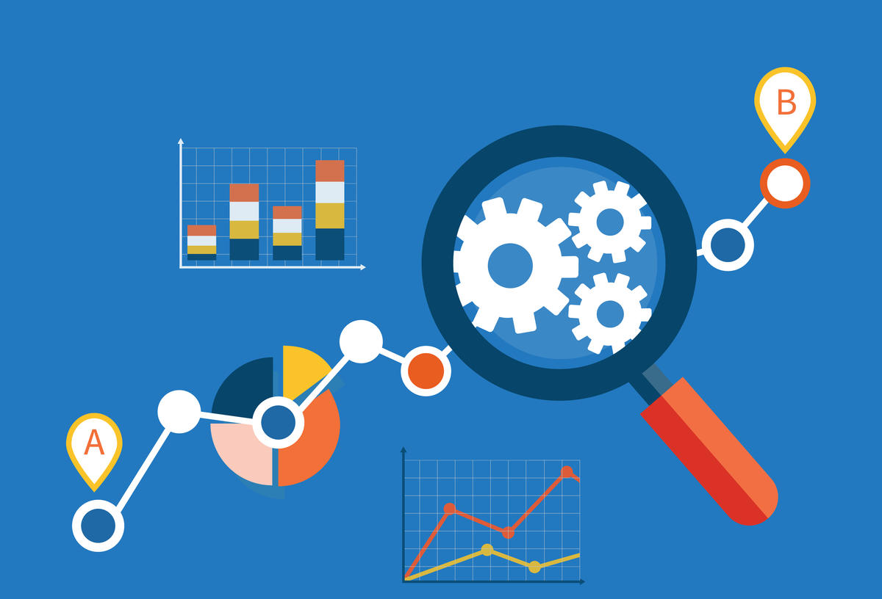
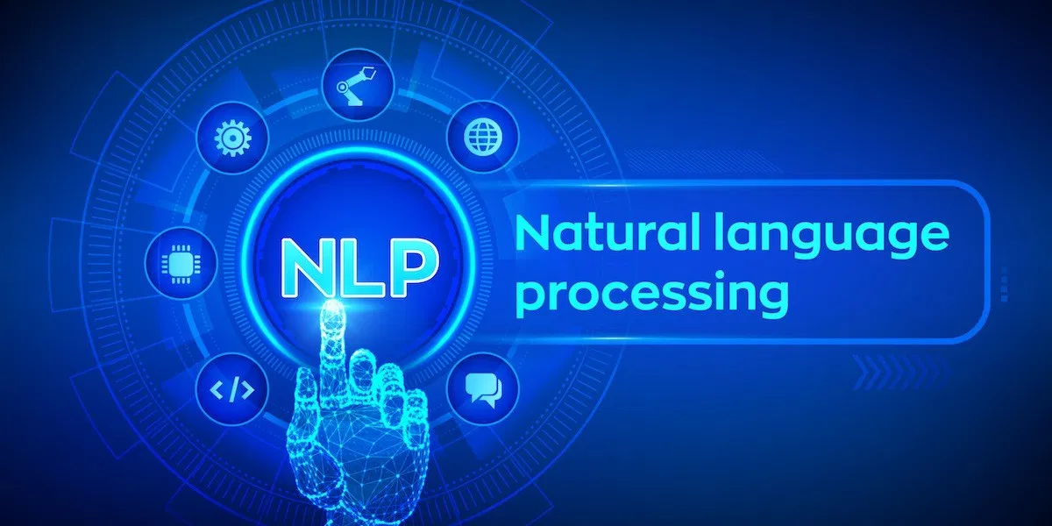
How did we do it?
A chat log is uploaded.
Our algorithm will iterate through the entirety of the chat and keep track of the statistics we want to present.
For sentiment analysis, we use natural language processing technologies.
We use the data to make graphs to display to the user.

Slide 5
Demo

Slide 6

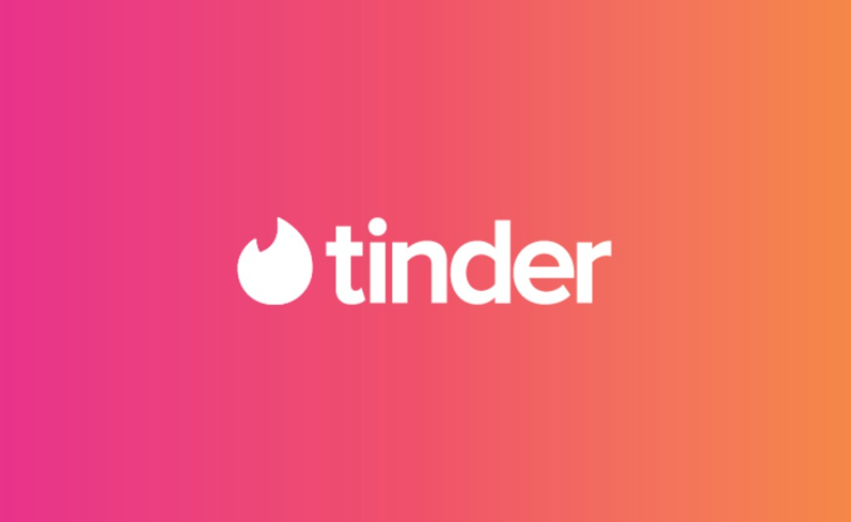



What can we do to improve?
Automatically obtain the chat logs
Include a login system that links social media platforms to our application so that it is more convenient for the user to obtain their chat logs.
Extend this application to target other users
People who are looking for romantic partners to save them time. (I.E. Tinder chat logs)
People who are looking for a job. (I.E. LinkedIn chat logs)

Slide 7
Thank you!

